Slide 1
A Reproduction Study
Kinematic-Wave-Based Adaptive Transit Signal Priority Control using Genetic Algorithm
Original paper: Behbahani & Poorjafari (2022), IET Intelligent Transport Systems, 17(5), 912-928
DOI: 10.1049/itr2.12316
Reproduced from scratch • Classical IS methods • No deep learning / RL
Notes:
This is a reproduction study of the KATC controller. Goal: reimplement the method from scratch and honestly evaluate what reproduces and what doesn't.

Slide 2
Background & Problem
02
Transit Signal Priority (TSP): give buses priority at intersections — but without unfairly penalising other traffic.
Conventional signals
KATC's idea
Optimise for vehicles — every car counts equally.
A full bus (40+ people) is treated the same as one car.
Optimise for passengers — weight vehicles by how many people they carry.
A full bus gets priority proportional to its load.
The problem KATC solves: minimise average PASSENGER delay across both modes at a signalised intersection.
Notes:
Conventional signal control counts vehicles. KATC counts people — so a full bus is prioritised over lightly-loaded cars. That passenger-based objective is the paper's core idea.

Slide 3
The Paper's Method — KATC
03
A closed control loop that re-optimises the signal every cycle over a 3-cycle horizon:
1
Read traffic state + bus position & occupancy (via V2I)
Objective
minimise
2
Model predict delay for any plan — kinematic-wave shockwave analysis
average
passenger
delay
3
Optimise genetic algorithm searches green splits + phase sequence
4
Actuate deploy best plan, advance one cycle, repeat
total passenger-seconds of delay ÷ passengers served (Eq. 43)
Notes:
KATC has four elements in a loop: read state, model delay, optimise with a GA, actuate. Updated every cycle. The objective is average passenger delay — Eq 43.

Slide 4
The Paper's Results
04
Three controllers compared across 35 scenarios (7 saturation levels x 5 occupancy levels):
KATC-2
green + phase sequence
best — lowest passenger delay
Key finding
Gains are LARGEST at
KATC-1
green time only
middle
low saturation
& high occupancy
SYNCHRO
vehicle-based baseline
highest delay
KATC-2 reduces passenger delay vs both baselines; phase-sequence optimisation adds the extra edge.
Notes:
Paper's result: KATC-2 best, KATC-1 middle, SYNCHRO worst. Improvements largest at low DOS and high occupancy. Remember this — our reproduction diverges exactly here.

Slide 5
Information-Systems Methods Used
05
1
Genetic Algorithm
the optimiser — searches signal plans (MINLP)
2
Metaheuristic search
elitism, tournament, crossover, adaptive mutation
3
Epsilon-greedy (bandit)
picks phase sequence from measured bus delay
4
Kinematic-wave modelling
analytical delay surrogate — the GA's fitness
5
Constraint handling
valid signal plans only (cycle, min-green, barrier)
6
Discrete-event simulation
SUMO software-in-the-loop evaluation
Notes:
Six classical IS methods. The GA is primary; everything else supports it. Note: epsilon-greedy is a bandit heuristic, NOT reinforcement learning — no reward-over-time, no policy.

Slide 6
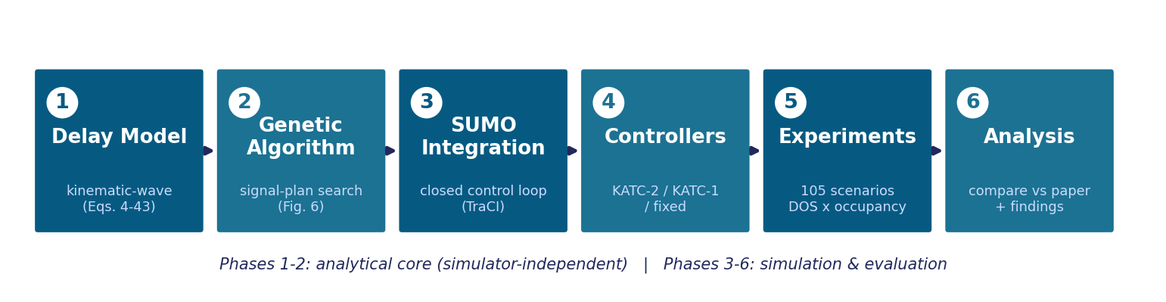
Our Reproduction — Architecture
06
Every phase maps to a section of the paper and was unit-tested (37 tests) or validated in simulation.
Notes:
Six phases. Phases 1-2 are the analytical core, pure Python, simulator-independent. Phases 3-6 are simulation and evaluation. Each maps to the paper.

Slide 7
Phase 1 — The Delay Model
07
The engine that predicts delay for any signal plan — the GA's fitness function.
Fundamental diagram triangular flow-density → shockwave speeds
Eqs. 2-3
22
General-traffic delay queue formation, dissipation, residual carry-over
Eqs. 4-12
unit tests pass
PT-vehicle delay 4 cases x sub-cases by bus position & saturation
Eqs. 13-42
Validated by physical sanity + an internal identity: the oversaturated queue equation reduces exactly to the undersaturated one.
Average passenger delay combine both modes, weight buses by occupancy
Eq. 43
Notes:
Phase 1 builds the kinematic-wave delay model. No worked example in the paper, so validated by physical sanity and internal consistency — Eq 11 reduces to Eq 4 when residual is zero.

Slide 8
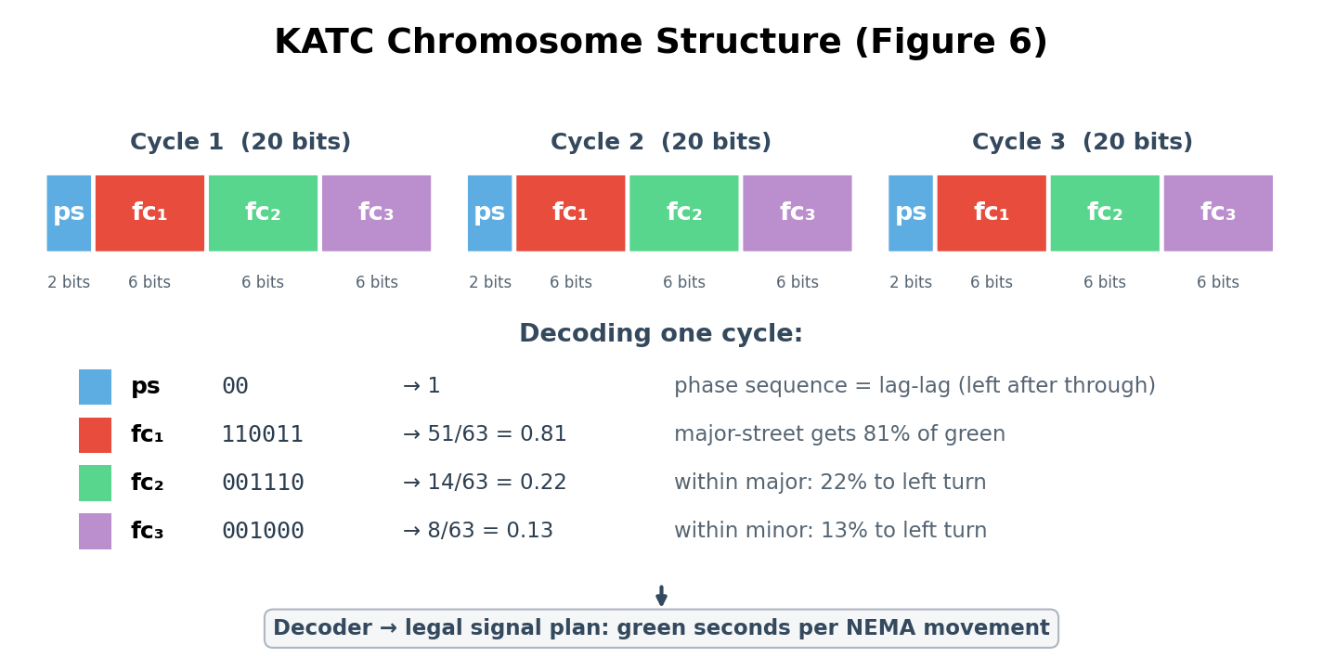
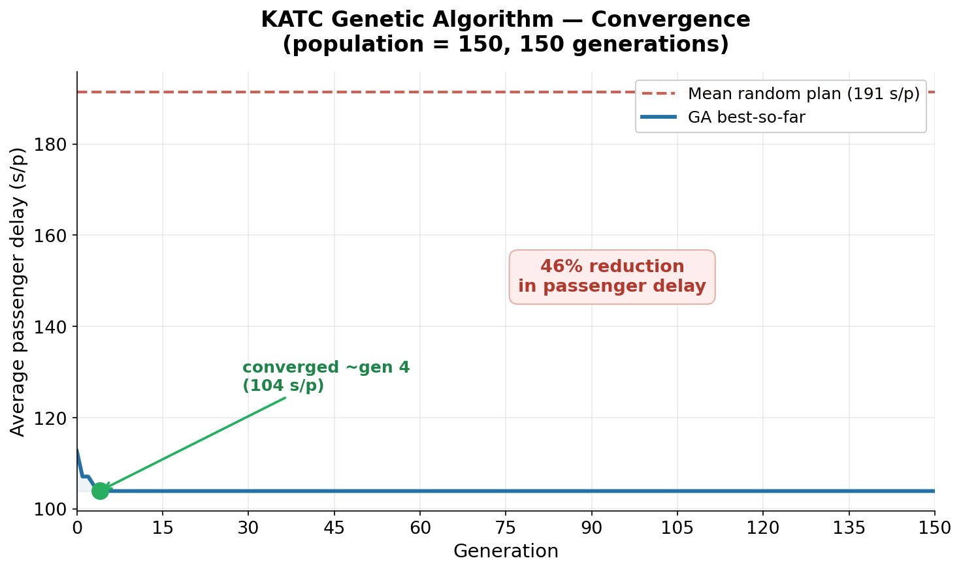
Phase 2 — The Genetic Algorithm
08
Why a GA? the problem is mixed-integer & non-linear — discrete phase sequence, non-smooth delay. Gradient methods can't; the GA only needs to score candidates.
Config (verified): population 150 · 150 generations · elitism · mask crossover · adaptive mutation 0.01→0.02 · fitness = 1/avg passenger delay
Result: ~46% delay reduction vs random, converges in ~25 generations (<3s) — matches the paper.
Notes:
Star slide. Chromosome = 60-bit string encoding a 3-cycle signal plan (2-bit phase sequence + three 6-bit green-split factors per cycle). GA evolves a population toward low delay. Converges ~25 gens, 46% reduction. Be ready: this is NOT reinforcement learning.

Slide 9
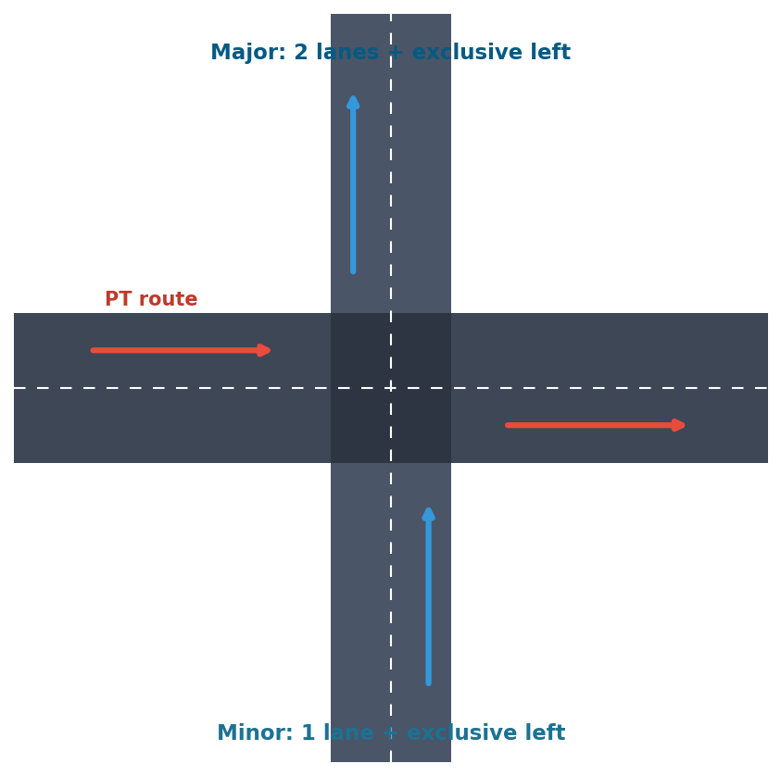
Phase 3 — Simulation (SUMO)
09
The closed control loop — replacing the paper's VISSIM + COM:
1
Read queue state + bus position/occupancy via TraCI
2
Optimise run KATC (Phases 1-2) to pick the plan
3
Actuate write NEMA signal plan back to SUMO
4
Step advance one cycle, repeat
Full NEMA dual-ring signal (8 movements, exclusive lefts, lead/lag) — chosen so the phase-sequence variable actually matters.
Notes:
Phase 3 puts the controller in SUMO (substituting VISSIM). Built the Fig 7 intersection, the 8 bus routes, and the read-optimise-actuate loop over TraCI. Full NEMA dual-ring so phase sequence is meaningful.

Slide 10
Reproducibility Challenges
010
What the paper didn't fully specify — and how we reconstructed it (each documented):
VISSIM → SUMO
commercial simulator (trial disables control interface) → open-source SUMO+TraCI
SYNCHRO → Webster
commercial baseline → fixed-time Webster plan
Intersection geometry
Fig. 7 under-specified → reconstructed exclusive-left lanes, caught by watching the sim
Coefficient-factor mapping
3-factor → 8-movement mapping not published → documented dual-ring interpretation
Phase-sequence in delay
analytical model is sequence-invariant → measured from live simulation instead
Reconstructing under-specified detail IS a reproducibility finding — not a shortcut.
Notes:
These aren't failures — they're the findings of a reproduction study. The paper's terse spec forced principled choices, each documented. This slide shows depth.

Slide 11
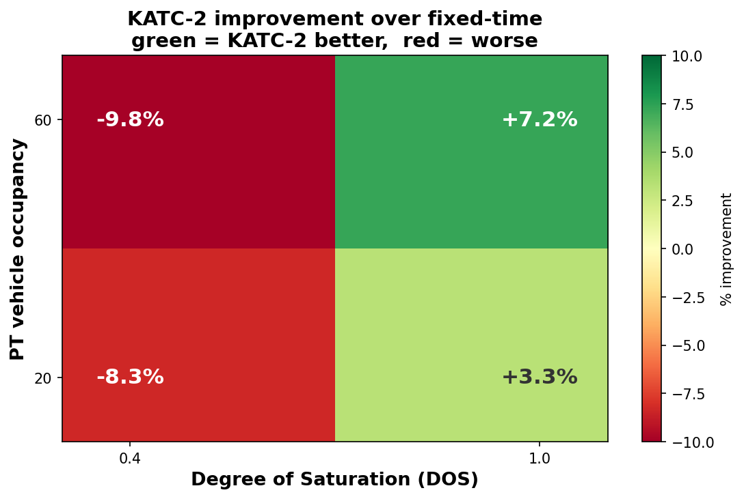
Our Results — The Key Finding
011
KATC-2 partially reproduced:
✓ High saturation
KATC-2 beats fixed-time (+5-11%) — matches the paper's direction
✗ Low saturation
KATC-2 loses to fixed-time — the OPPOSITE of the paper
Likely causes: GA re-optimisation churn hurts stability at low demand; analytical fitness diverges from SUMO reality; uncalibrated fundamental-diagram parameters.
Notes:
Our central finding: KATC-2 reproduces the paper at high DOS but INVERTS at low DOS. Honest analysis of WHY — re-optimisation instability, analytical-vs-simulated mismatch, uncalibrated FD parameters — is the intellectual payoff.

Slide 12
Conclusion
Reproduced
the full method — delay model, GA optimiser (converges as reported), and the closed simulation loop
Diverged
KATC beat fixed-time at high saturation but not low — the reverse of the paper
Learned
a reproduction's value is understanding WHERE and WHY a method holds or breaks, not matching every number
37 unit tests • 6 phases • 105-scenario grid • solo reproduction
Notes:
Three takeaways: reproduced the method, diverged at low DOS, and the real lesson is understanding why. End confidently — a rigorous honest reproduction is exactly the assignment.

